Slide 1
Nagios
It is open source software for continuous monitoring of systems, networks, and infrastructures.
It runs plugins stored on a server which is connected with a host or another server on your network or the Internet.
In case of any failure, Nagios alerts about the issues so that the technical team can perform recovery process immediately

Slide 2
Need Nagios tool
Detects all types of network or server issues
Helps you to find the root cause of the problem which allows you to get the permanent solution to the problem
Active monitoring of your entire infrastructure and business processes
Allows you to monitors and troubleshoot server performance issues
Helps you to plan for infrastructure upgrades before outdated systems create failures
You can maintain the security and availability of the service
Automatically fix problems in a panic situation

Slide 3
Features of Nagios
Relatively scalable, Manageable, and Secure
Good log and database system
Informative and attractive web interfaces
Automatically send alerts if condition changes
If the services are running fine, then there is no need to do check that host is an alive
Helps you to detect network errors or server crashes
You can troubleshoot the performance issues of the server.
The issues, if any, can be fixed automatically as they are identified during the monitoring process
You can monitor the entire business process and IT infrastructure with a single pass

Slide 4
Continued...
The product’s architecture is easy writing new plugins in the language of your choice
Nagios allows you to read its configuration from an entire directory which helps you to decide how to define individual files
Utilizes topology to determine dependencies
Monitor network services like HTTP, SMTP, HTTP, SNMP, FTP, SSH, POP, etc.
Helps you to define network host hierarchy using parent hosts
Ability to define event handlers which runs during service or host events for proactive problem resolution
Support for implementing redundant monitoring hosts

Slide 5
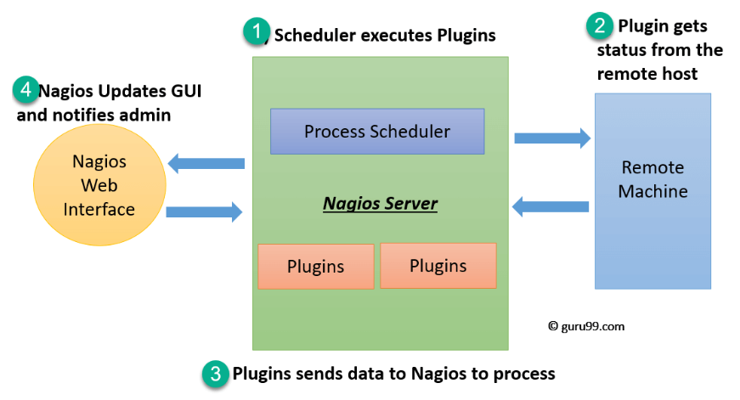
Nagios Architecture
Nagios is a client-server architecture.
Nagios server runs on a host
Plugins running on all the remote hosts which should be monitored.

Slide 6
Architecture
The scheduler is a component of server part of Nagios. It sends a signal to execute the plugins at the remote host.
The plugin gets the status from the remote host
The plugin sends the data to the process scheduler
The process scheduler updates the GUI and notifications are sent to admins

Slide 7
Plugins
Nagios plugins provide low-level intelligence on how to monitor anything and everything with Nagios Core.
Plugins operate acts as a standalone application, but they are designed to be executed by Nagios Core.
It connects to Apache that is controlled by CGI to display the result.
A database connected to Nagios to keep a log file.

Slide 8
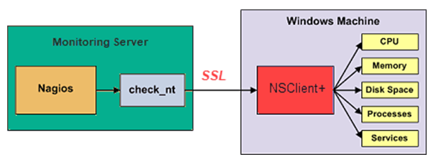
How do plugins work?
Check_nt is a plugin to monitor a windows machine which is mostly available in the monitoring server
NSClinet++ should be installed in every Windows machine that you wants to monitor
There is an SSL connection between the server and the host which continuously exchange information with each other

Slide 9
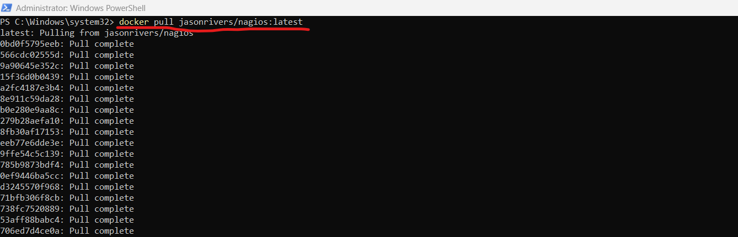
Installing Nagios4 with Docker
Open Dockers
Open Powershell as Run as Administrator and then pull the nagios from docker hub using command :
docker pull jasonrivers/nagios:latest

Slide 10
Install Nagios Tool from Docker Hub
Open Docker Desktop
Open PowerShell as administrator and type the following command
docker pull jasonrivers/nagios:latest
Pull: This command is used to download a Docker image from a container registry.
jasonrivers/nagios: This is the name of the Docker image. In this case, it's an image created by someone named Jason Rivers, and it contains Nagios, which is a popular open-source monitoring system.
:latest: This is a tag for the image. In Docker, images can have different versions or tags. ":latest" typically refers to the latest version of the image.
By running the command "docker pull jasonrivers/nagios:latest," the Docker will download the latest version of the Nagios image created by Jason Rivers from the Docker Hub or another container registry. Once the download is complete, you can use this image to run Nagios containers on your system.

Slide 11
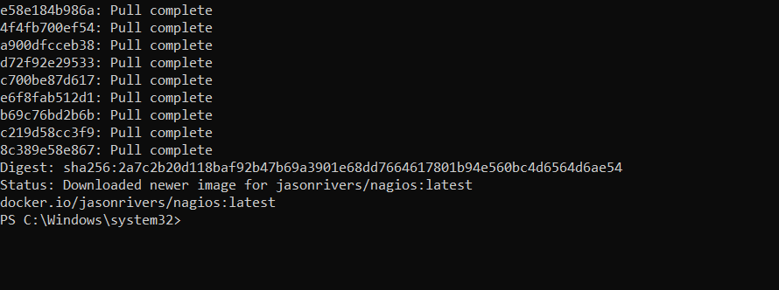
Shows Nagios is pulled successfully

Slide 12
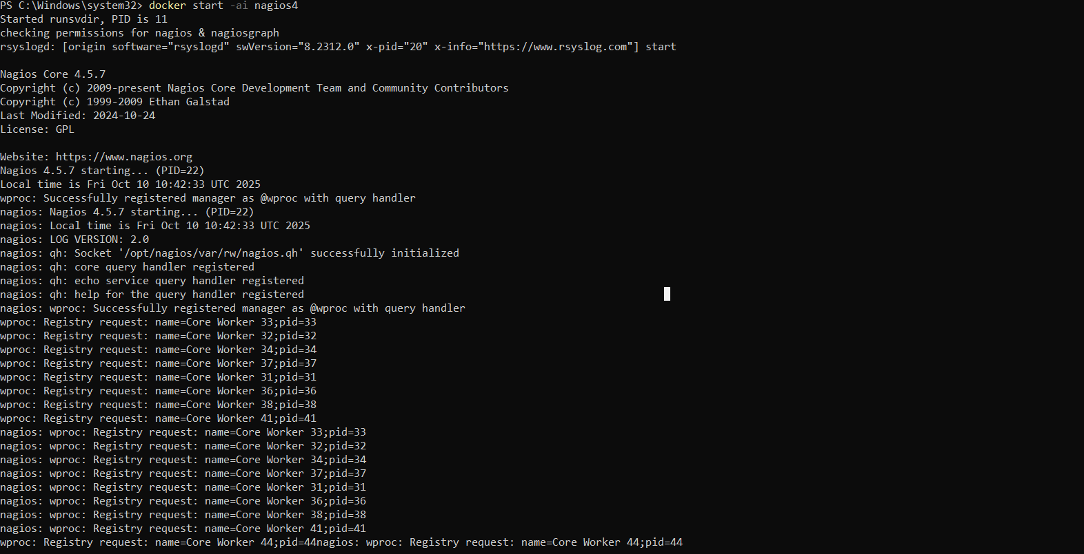
Run Nagios
PS :/windows/system32> docker start -ai nagios4
It should show Nagios is Successfully launched

Slide 13
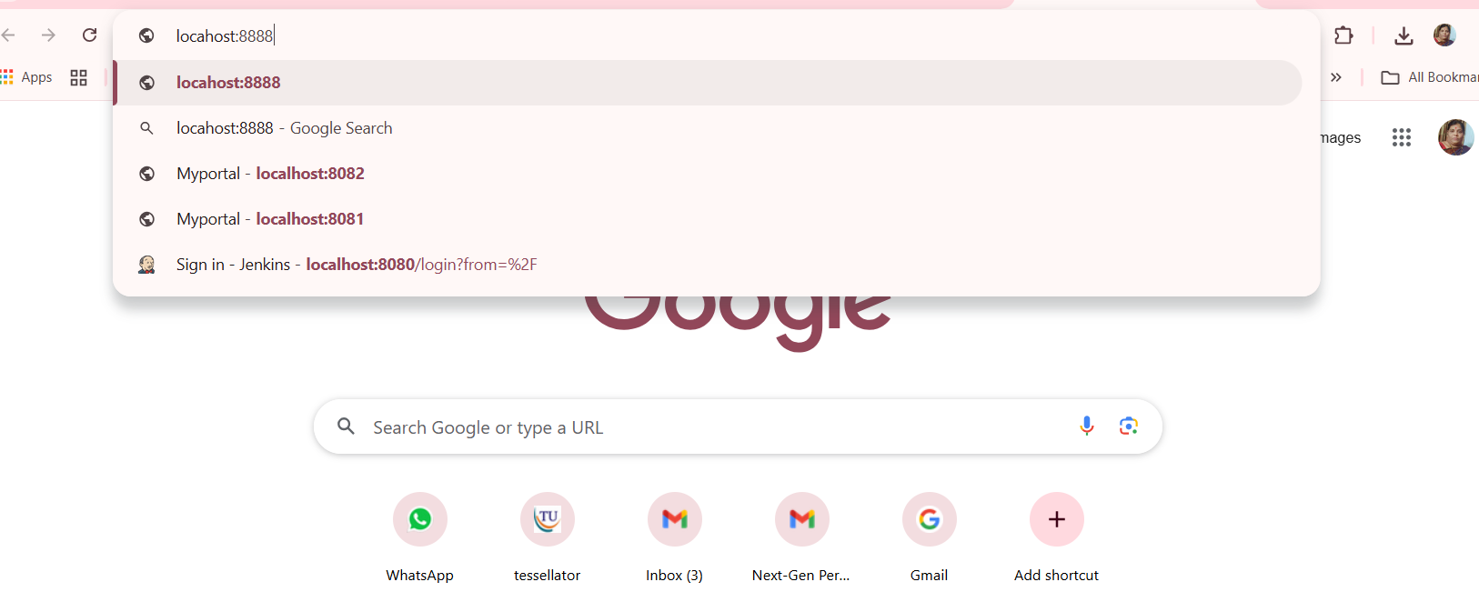
Open the Nagios Webui on port 8888. (Type locahost:8888)

Slide 14
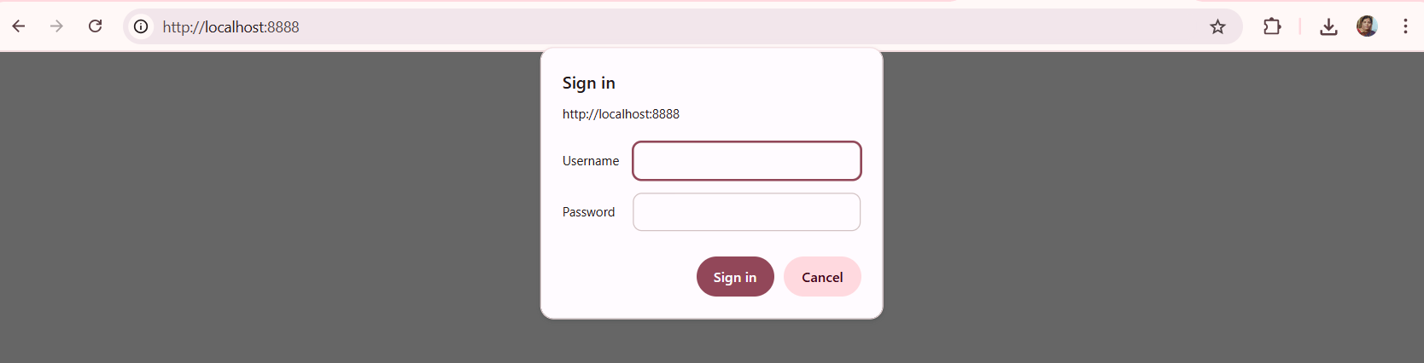

Slide 15
Setting Credentials for web interface
Open the Nagios Webui on port 8888. (Type locahost:8888)
Enter username : nagiosadmin
Enter password : nagios

Slide 16
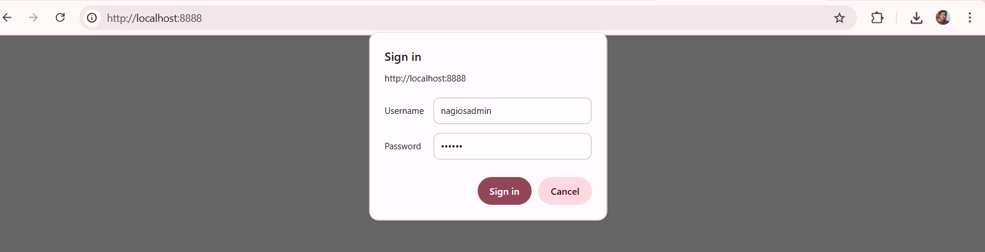

Slide 17
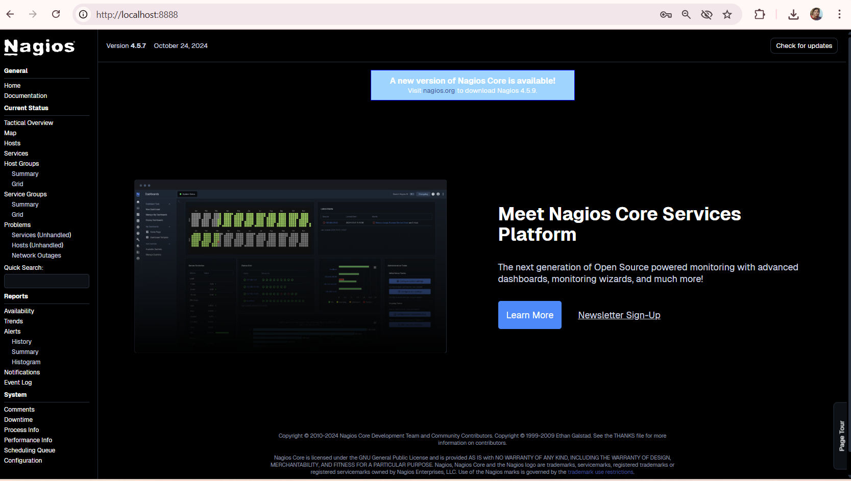
Nagios dashboard to monitor services

Slide 18
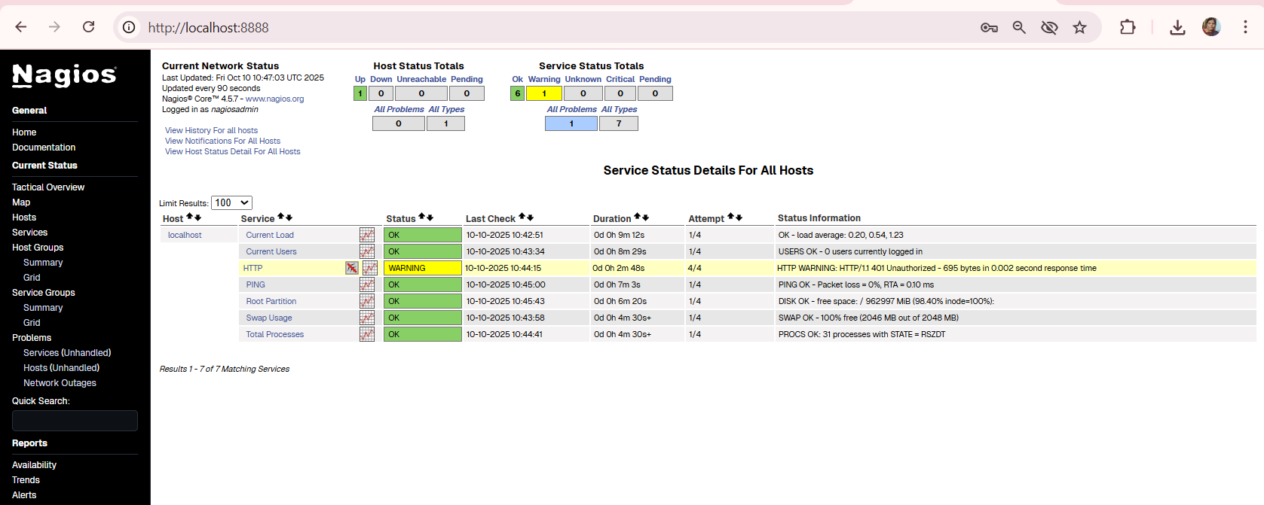
Nagios services

Slide 19
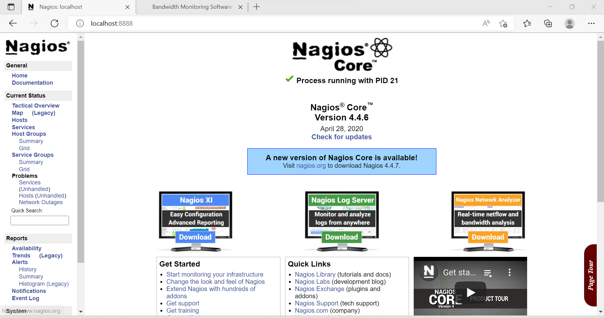
Nagios dashboard to monitor services

Slide 20
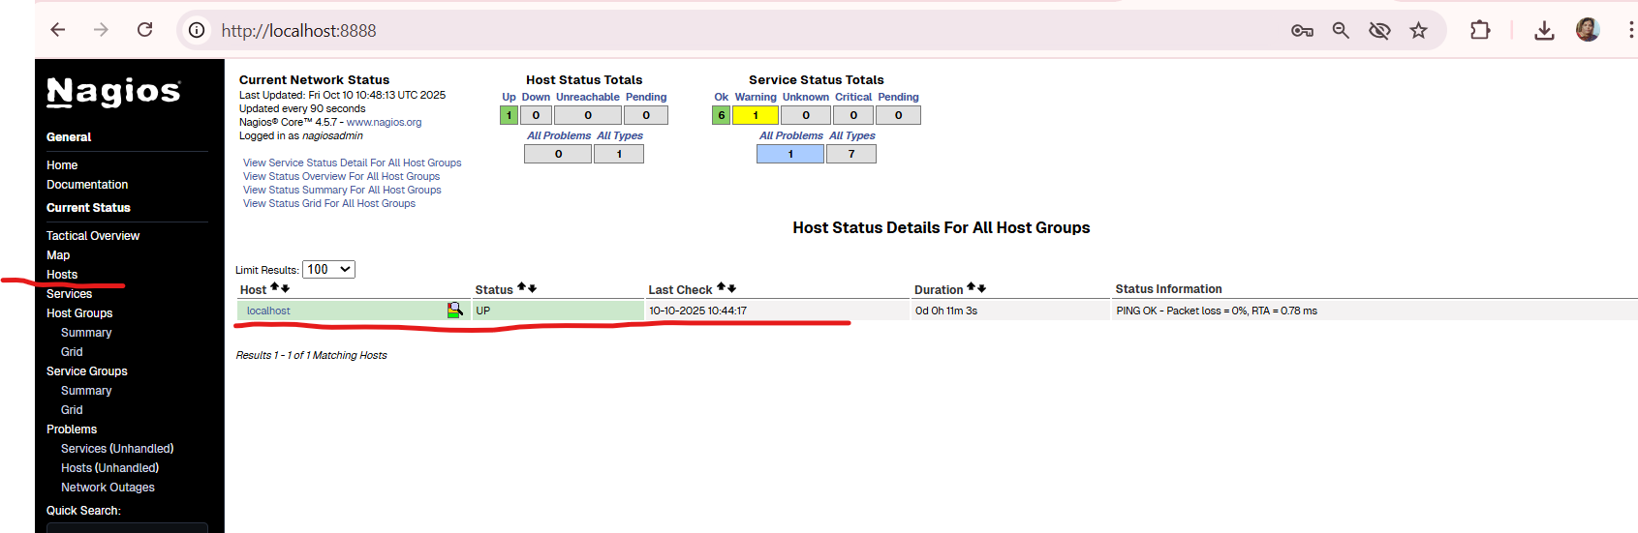
Click on HOST on left side
It shows localhost
Now click on localhost

Slide 21
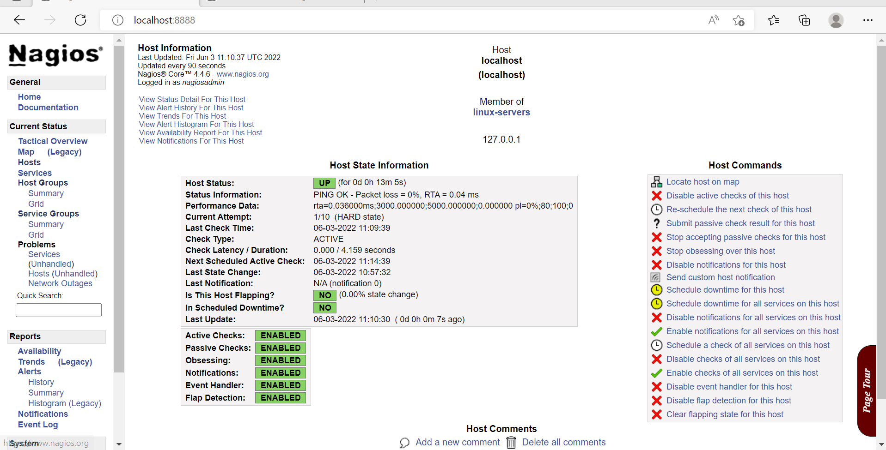
Click to view any service on left side

Slide 22
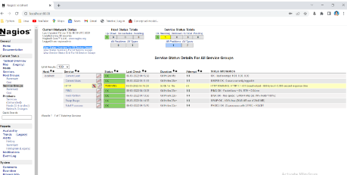
Services like Currentload, HTTP, PING,etc can viewed by clicking on the highlighted link

Slide 23
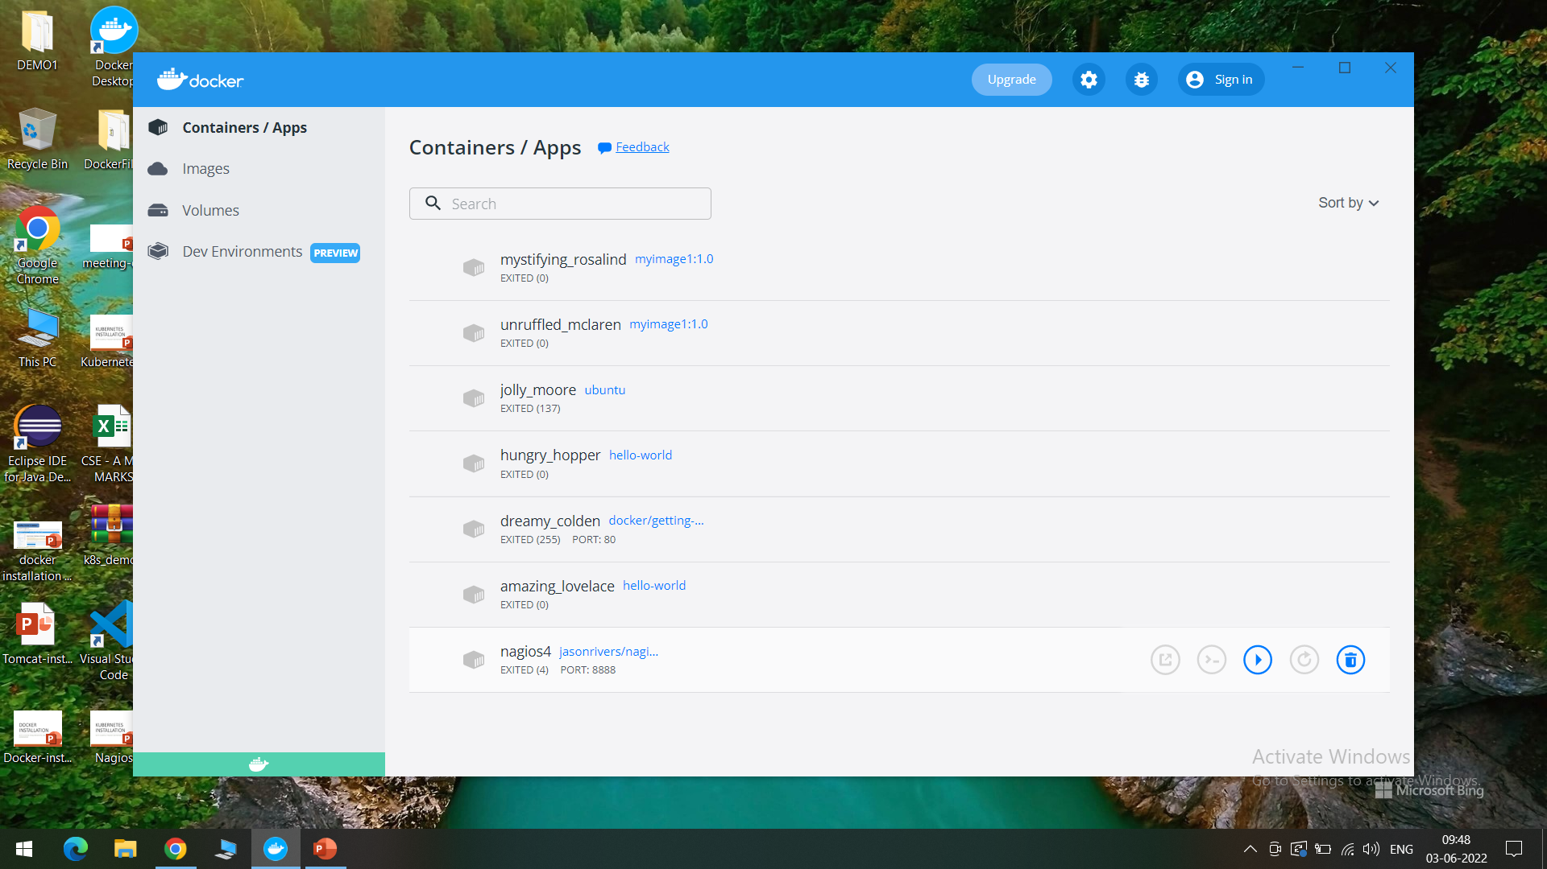
If we observe the docker containers in DockerHub, we can see the latest Nagios Installed running on port:8888

Slide 24
Thank You

